Slide 1
Developing Requirement
Object Oriented Software Engineering
Presented by: Dr. Nadeem Mahmood

Slide 2
Domain Analysis
The process by which a software engineer learns about the domain to better understand the problem:
The domain is the general field of business or technology in which the clients will use the software
domain expert is a person who has a deep knowledge of the domain
Benefits of performing domain analysis:
Faster development
Better system
Anticipation of extensions

Slide 3
Domain Analysis document
Introduction
Glossary
General knowledge about the domain
Customers and users
The environment
Tasks and procedures currently performed
Competing software
Similarities to other domains

Slide 4
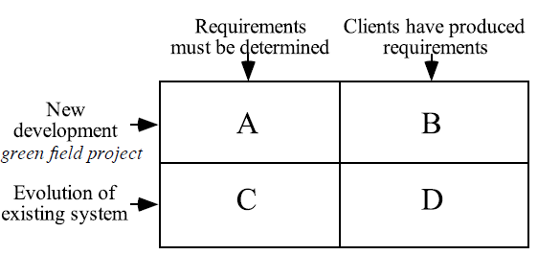
The Starting Point for Software Projects

Slide 5
Defining the Problem & Scope
A problem can be expressed as:
A difficulty the users or customers are facing,
Or as an opportunity that will result in some benefit such as improved productivity or sales.
The solution to the problem normally will entail developing Software
Narrow the scope by defining a more precise problem
List all the things you might imagine the system doing
—Exclude some of these things if too broad
—Determine high-level goals if too narrow

Slide 6
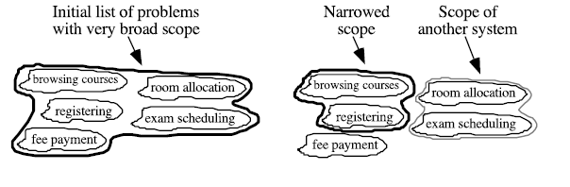
University Registration System

Slide 7
Types of Requirements
Functional requirements
• Describe what the system should do
Quality requirements
• Constraints on the design to meet specified levels of quality
Platform requirements
• Constraints on the environment and technology of the system
Process requirements
• Constraints on the project plan and development methods

Slide 8
Functional Requirements
What inputs the system should accept
What outputs the system should produce
What data the system should store that other systems might use
What computations the system should perform
The timing and synchronization of the above

Slide 9
Quality Requirements
All must be verifiable
Examples: Constraints on
Response time
Throughput
Resource usage
Reliability
Availability
Recovery from failure
Allowances for maintainability and enhancement
Allowances for reusability

Slide 10
Use Cases
A use case is a typical sequence of actions that a user performs in order to complete a given task
The objective of use case analysis is to model the system from the point of view of
… how users interact with this system
… when trying to achieve their objectives.
It is one of the key activities in requirements analysis
A use case model consists of
— a set of use cases
— an optional description or diagram indicating how they are related

Slide 11
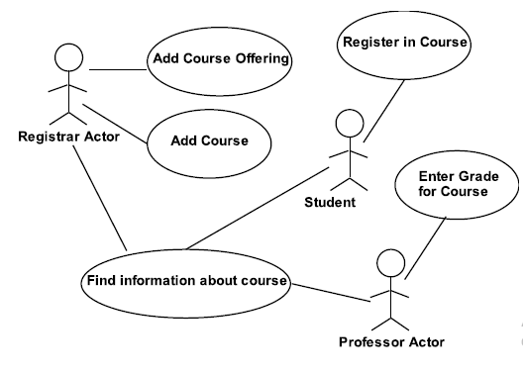
Example Use case diagram

Slide 12
What to cover in a Use Case
Name: Give a short, descriptive name to the use case.
Actors: List the actors who can perform this use case.
Goals: Explain what the actor or actors are trying to achieve.
Preconditions: State of the system before the use case.
Summary: Give a short informal description.
Related use cases.
Steps: Describe each step using a 2-column format.
Postconditions: State of the system in following completion.
Alternative scenario: incase other options

Slide 13
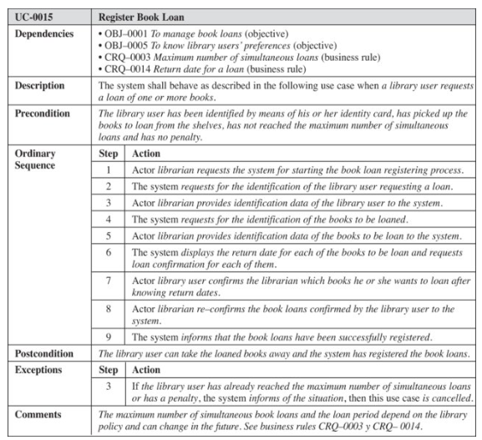

Slide 14
Extensions & Inclusions
Extensions
• Used to make optional interactions explicit or to handle exceptional cases.
• Allow one to express commonality between several different use cases.
Inclusions
• Are included in other use cases
—Even very different use cases can share sequence of actions.
—Enable you to avoid repeating details in multiple use cases.e basic use case simple.

Slide 15
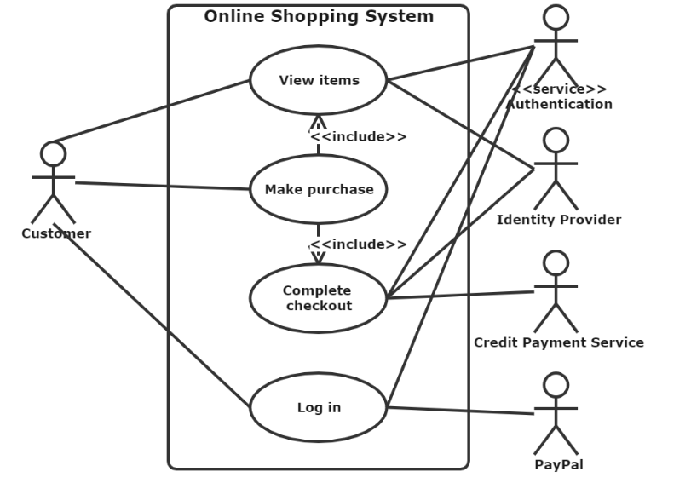

Slide 16
